Slide 1
Report
Oct-2023 MP Inspection BFX – AT100
Date : 15-Dec-2023
Prepared by: Rachel Ruan

Slide 2
Issue Description
03-Oct, ALT customer complain [BFX-AT100] Sep – 2023 Mass production issue.
Overall inspection result => Conditional Pass
Defect Total:
•Critical
Abnormal reboot after System hang up * 1pcs

Slide 3
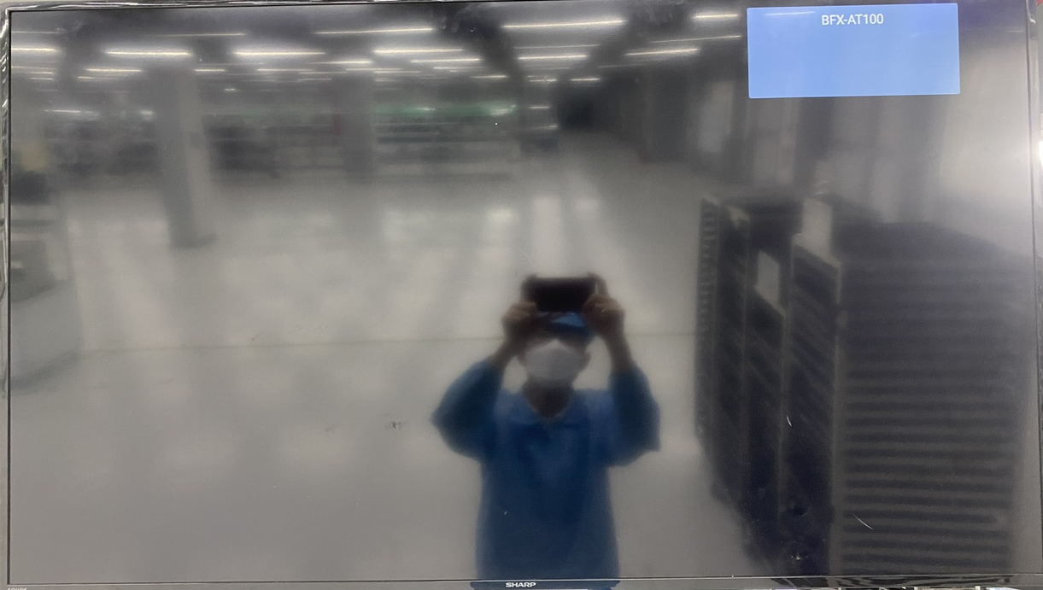
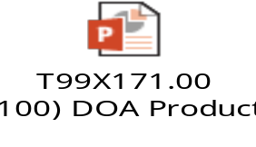
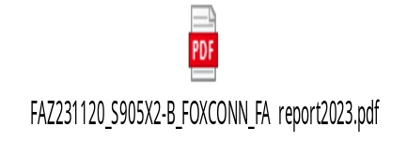
1. Abnormal reboot after System hangup
Issue Description | FA | Root cause | Actions | Status
Symptom: Reboot Type: Critical Defect unit Q’ty : 1pcs / 1000pcs Defect rate : 0.1% SKB SN: 2149688001202301273347 | 1. Fail symptom: As ALT feedback that they found out 1pcs defect: • Normal operation for several minutes after power on • Abnormal reboot and System hang up. 2. Check FATP data → Product test pass normally. 3. Check visual status -> No found abnormal 4. Check RS232 log found out abnormal the same issue as before follow SoC AMLOGIC. 5. Suspect SoC material U1 (P/N: 002.02753.005. DC: 2328, Vendor: AMLOGIC) | 1. Occur cause: Suspect SoC material U1 (P/N: 002.02753.005. DC: 2328, Vendor: AMLOGIC). (The same old issue follow SoC (P/N: 002.02753.005. DC: 2309, Vendor: AMLOGIC)). 2. Escape cause: FATP can’t cover this issue | 1. Swap the SoC U1 to verify issue. Owner: PE Long. Due date: 12/19 2. Co-work with RD team, how to cover this issue at FATP ,Owner :RD Cooper, Jerry . Due date: 12/30 3. On 11/29, Fii send NG the same issue to vendor AMLOGIC further analysis. Status: Closed 4. On 12/15, AMLOGIC vendor feedback the chip encrypted so the chip need to be decrypted by customer if performing SLT. ➔ We hope that ALT customer will support decryption the SoC for AMLOGIC vendor to further analysis.
Re-boot

